Slide 1

Online Quiz System
Using Django

Slide 2
Online Quiz System
Online Quiz Web App allows teacher to create and manage category wise questions and view students results
Online Quiz Web App helps student to take quiz and view result.
Time limit to attempt each question is predefined by teacher.
Student can view Skipped, Right Answer Count and Percentage at end of quiz.

Slide 3



Technologies Used
Django
Object Oriented Programming
HTML, CSS
JS
SQLite

Slide 4
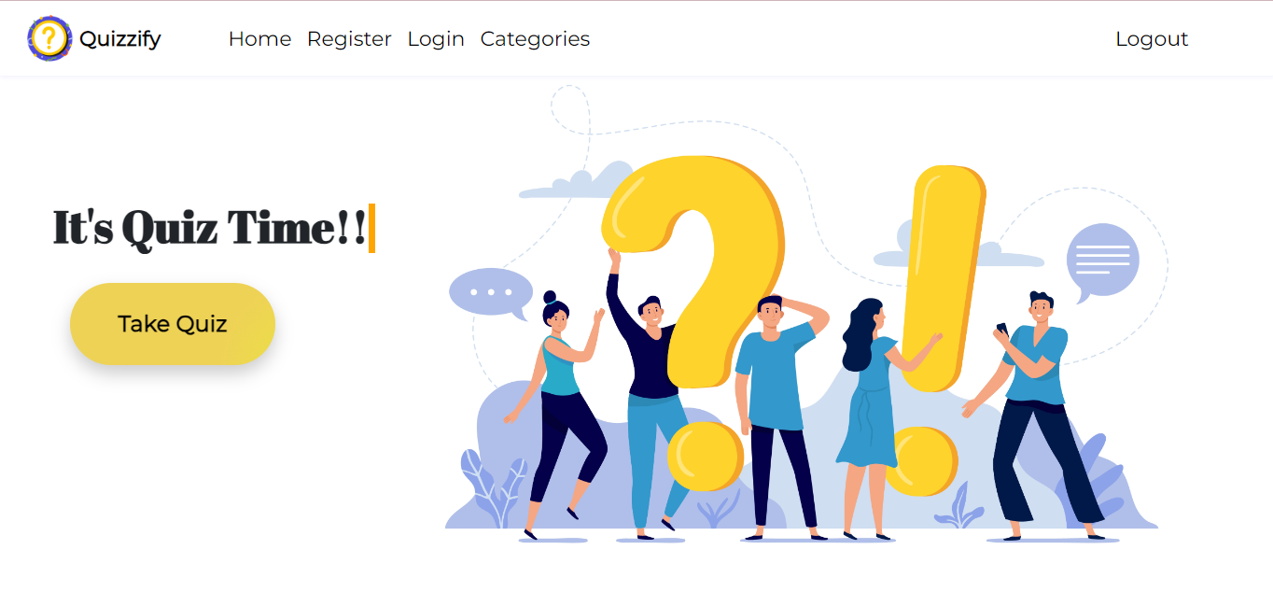
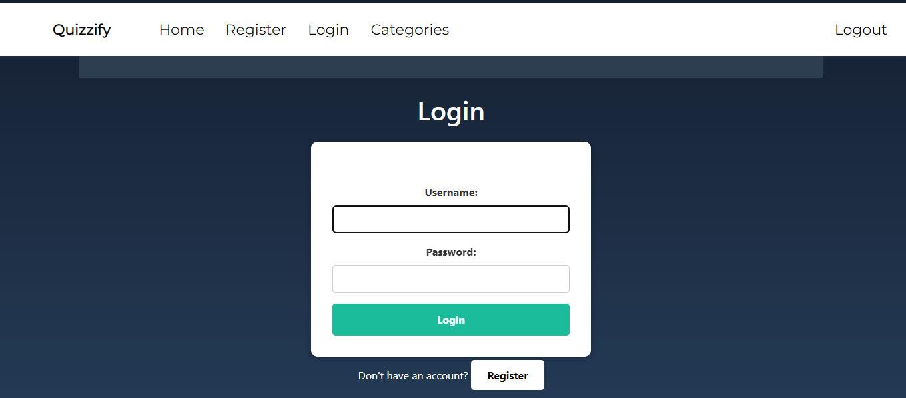
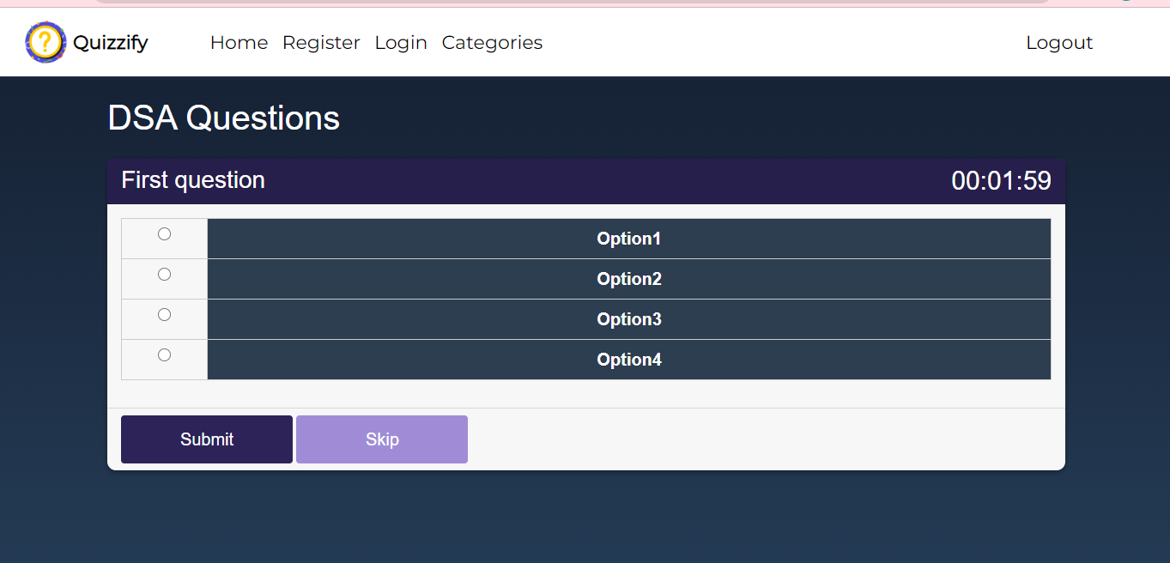
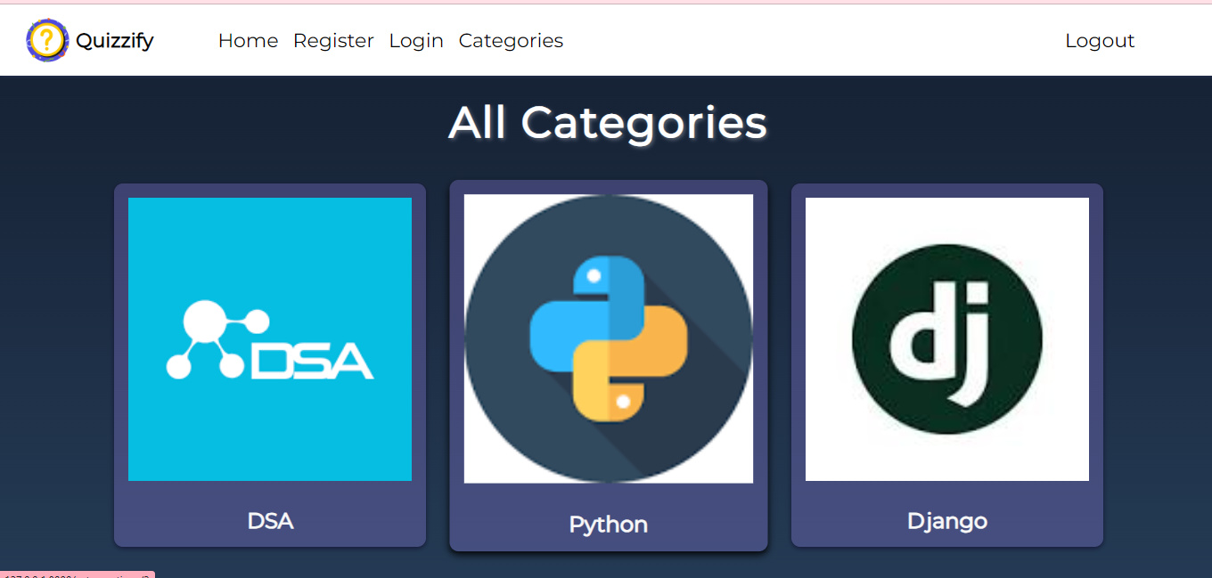
Frontend:
Designed using HTML, CSS and JS

Slide 5
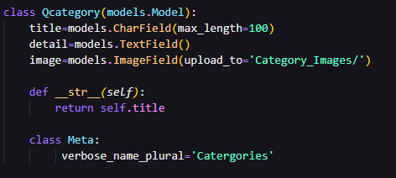
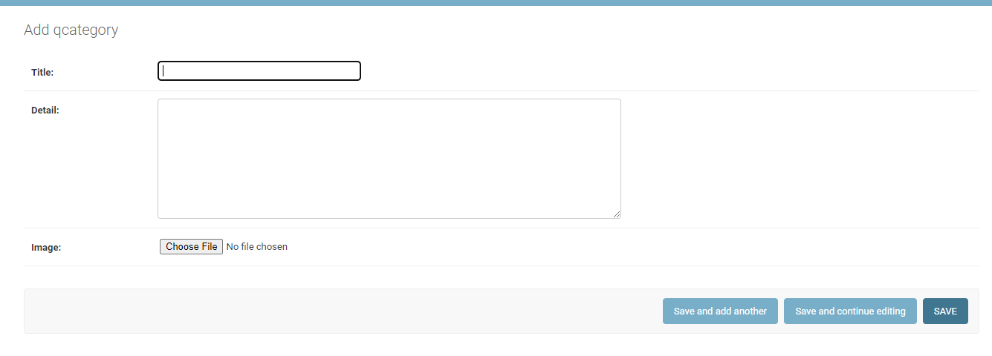
Database Models

Slide 6
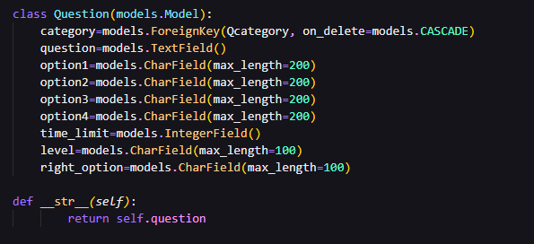
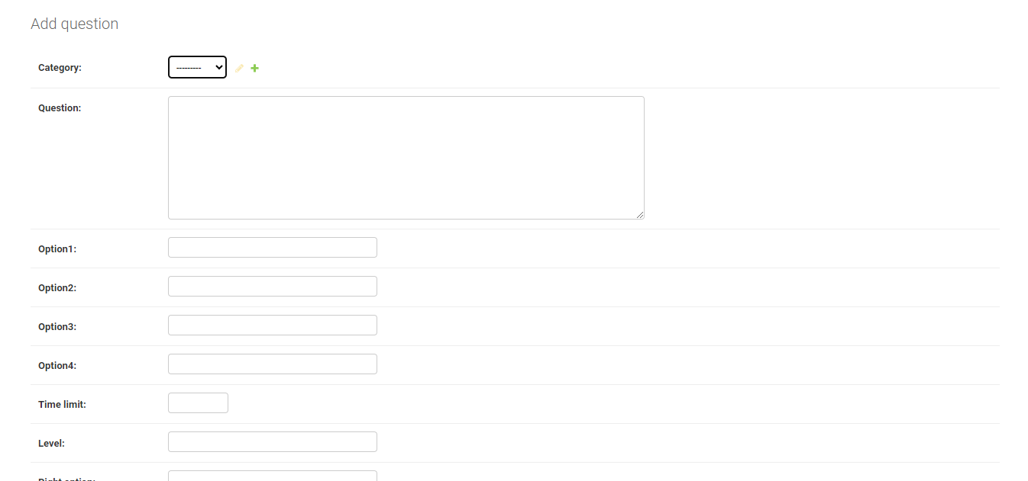
Database Models

Slide 7
Thank You!

